Slide 1
The New Curriculum Transfer From Paper to Practice

Slide 2
Is this a technology, a theory or a practice?

Slide 3
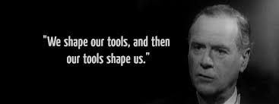
Curriculum as a tool or theory that can shape us, rather than we shaping it: pedagogy as an educational philosophy is that shaping

Slide 5
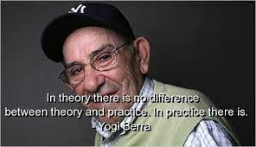

Slide 6
In Theory everything is possible; however, I live in Practice and the road to Theory has been washed away.

Slide 7
Key questions we do not ask ourselves
What is practice rather than theory in an educational setting’s curriculum implementation?
Responsibility vs Compliance
Curriculum as Human Relational Journey

Slide 8
Practice is pedagogy, pedagogy is anthropology of learning

Slide 9
3 pedagogical ingredients that correspond to our human structure and that are necessary for implementation
A Knowledge curriculum only makes sense in relation to meaning
Show the connection between what is studied and the whole: the search for meaning.
All curriculum begins with the experience of the student.
Make the students see concretely how what is being studied has to do with themselves, with their concrete experience.
Realism means the object studied determines the method of reasoning, the engagement with the subject studied.
Model, emphasize, educate toward a seriousness in the use of reason and the method of knowledge proper to a discipline. Avoid educational scientism.

Slide 10
Compliance vs. responsibility
“To overcome this compliance fatigue, organisations should move away from traditional tick box approaches to compliance in favour of a more holistic cultural approach.”
Clear expectations and goals: knowledge, skills, pupil profile; internal and external accountability, personal and collective.
Open Communication: this is not/working, here is how to change it.
Leadership and shared responsibility

Slide 11
The outcome and implementation are learners and persons in relationship to knowledge and others
Is there space in your implementation for this, is there accountability for it?

Slide 12
Our path: culture change, collective accountability for expectations not outcomes, shared responsibility

